Slide 1

Snowflake Program Accelerate Workshop
Author NG/Snowflake Team
Date October 2022
Version v0.3
Status DRAFT

Slide 2
Summary
On Andi Kataboutis’s request, Snowflake is assisting NationalGrid with accelerating their journey to Snowflake. A workshop is setup to POC with NG real use cases to use new features of Snowflake.
There are 2 use cases selected for the Workshop:
Snowflake change data capture (CDC) using Streams
Snowflake ML capability using Snowpark and Python

Slide 3
Use Case 01
Snowflake Change Data Capture (CDC) using Steams

Slide 4
Detail
Use Case
Customer change data sync from Snowflake to selected target using Snowflake Streams and Tasks
Pre-requisite
Qlik Replicate syncs process of following Customer data change automatically from CSS to Snowflake Raw database already in place
Expected Outcome/Success Criteria
Sync customer change data to other Snowflake tables using Snowflake Streams and Tasks
Sync customer change data to Blob Storage using Snowflake Streams and Tasks
Sync customer change data to Azure Event Hub using Snowflake Streams and Tasks & Matillion
CSS Table Name | Record Count
DEV_CDP_DEVELOP_DB.CSS_CDP.CU03TB03_CRIT_ACCT | 46,152
DEV_CDP_DEVELOP_DB.CSS_CDP.CU04TB19_STREET | 248,149

Slide 5


Architecture

Slide 6
Use Case 02
Snowflake ML capability using Snowpark and Python

Slide 7
Detail
Use Case
Predict the probability of a customer enrolling into paperless billing
Pre-requisite
CUSTOMER_TENURE_WEB table is being populated based on customer e-bill, segmentation, enrollment analysis using 2021 US customer data by ZBR team
Predictive model is being created for the paperless billing
Expected Outcome/Success Criteria
Ease of feature engineering
Ability to specify Conda package versions
Ability to install packages via pip
Ability to install packages via custom channels (e.g, cond-forge, esri)
Ability to use internal Conda packages
Ease of use of platform’s APIs/libraries
Speed of execution
Assess ability of scaling of compute
Assess customization of compute
Assess how output can be stored for non-technical stakeholders
Assess how the platform interacts with Oracle/ SQL Server data sources
Assess logging capabilities
Assess alerting capabilities
Assess model monitoring
Assess data drift monitoring capabilities
Integration with CI/CD tools
Integration with version control

Slide 8
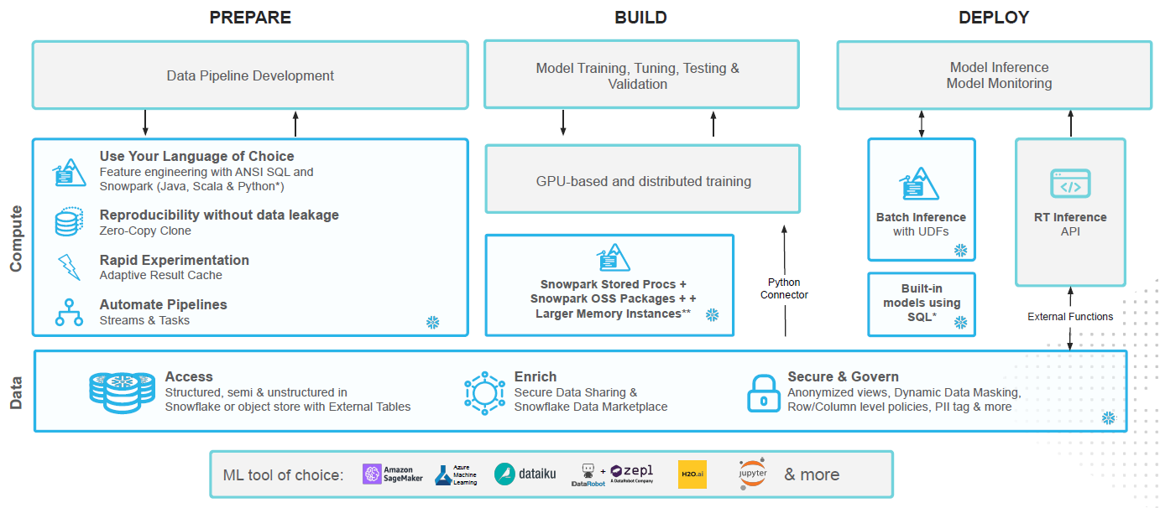
Snowpark Architecture

Slide 9
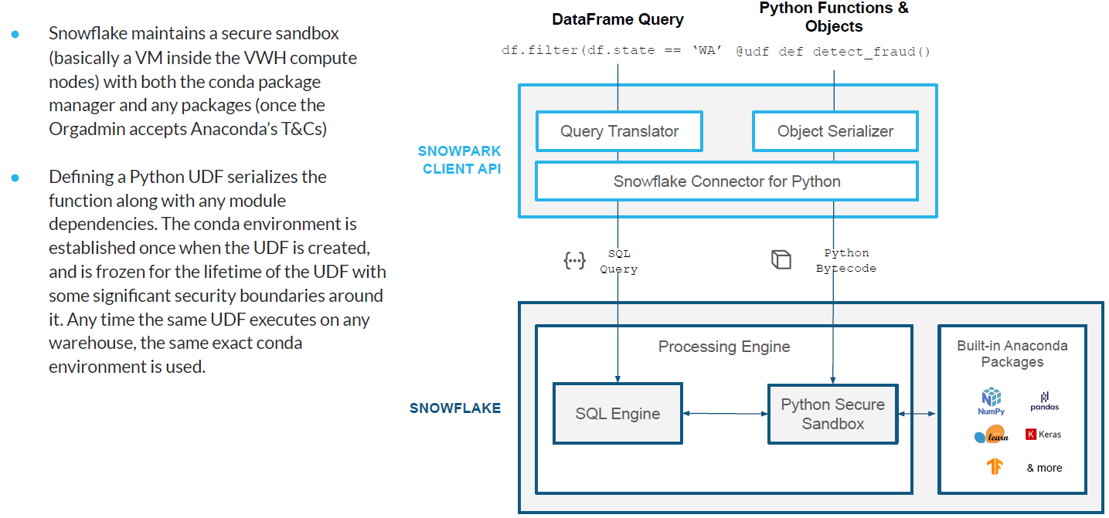
Snowpark Under the Hood

Slide 10

QuickStart - https://quickstarts.snowflake.com/guide/machine_learning_with_snowpark_python/index.html?index=..%2F..index#0
NG Snowflake Resource - https://confluence.us.ngridtools.com/display/EDPTEAM/Education

Slide 11
Next Steps
Snowflake Change Data Capture using Steams/Tasks
Complete Event Hub use case
Identify projects/programs where Snowflake CDC capabilities are needed
Start using Snowflake Streams and Tasks in such projects/programs
Snowpark ML capabilities using Python
Make sure GA release of Snowpark Python (expected in Nov 2022 but no final official confirmation yet) prior to any NG PROD releases – GA release in Nov 2022
Make sure to understand Snowpark 5GB sub-procedure memory limitation – Larger Snowpark servers with more memory are now available
Create new Snowflake standards and guidelines for Snowpark that includes:
Availability of multiple warehouses of different sizes
New roles with READ/SELECT permission for source data and CREATE or Modify OBJECT permissions in Target database to Snowpark users
Adjust current Snowflake CI/CD pipeline to include Snowpark code migration
Cost share plan

Slide 12


